Slide 1
MSCF Programming Prep
46-900
MSCF, Carnegie Mellon University
Day 5, Part 2:
Depth-First Search,
Fibonacci Numbers Again!

Slide 2
The Graph of Friends
A
B
C
D
E
F
G
H
Me
I
J
K
L
M
N
O
P
Q
R
S
T
U
V
W
X
Y
Ed
Z
Notes:
pow() takes two doubles and returns a double:
double sqrt = pow( 4.0, 0.5);
How is this implemented? It’s unnecessarily slow for integer powers, don’t use it for this!

Slide 3
Depth-First Search
Depth-First Search is what we are familiar with from an in-order traversal of a BST
  Has a natural recursive definition
    Can be defined iteratively similarly to BFS, using a stack rather than a queue
Useful for identifying connected components, solving mazes, compiler optimization logic, task scheduling (topological sort)
  Algorithms requiring backtracking
  Not useful for shortest path analysis
Notes:
pow() takes two doubles and returns a double:
double sqrt = pow( 4.0, 0.5);
How is this implemented? It’s unnecessarily slow for integer powers, don’t use it for this!

Slide 4
Depth-First Search Algorithm
# S is the set of all visited nodes,
# initially empty
# T is the tree of visited nodes, from some root
def DFS(G, cur, parent): # Pythonish pseudocode
if cur not in S: # else backtrack
S.add(cur)
T.add(cur, parent)
for v in G[cur]:
DFS(G, v, cur)
Notes:
pow() takes two doubles and returns a double:
double sqrt = pow( 4.0, 0.5);
How is this implemented? It’s unnecessarily slow for integer powers, don’t use it for this!

Slide 5
DFS Branch 1, Level 1
DFS(G, 'me', None) T
S == {'Me'}
'Me'
Notes:
pow() takes two doubles and returns a double:
double sqrt = pow( 4.0, 0.5);
How is this implemented? It’s unnecessarily slow for integer powers, don’t use it for this!

Slide 6
DFS Branch 1, To 1st Backtrack
T
S == {'Me','A','B'}
'Me'
A
B
Notes:
pow() takes two doubles and returns a double:
double sqrt = pow( 4.0, 0.5);
How is this implemented? It’s unnecessarily slow for integer powers, don’t use it for this!

Slide 7
DFS Branch 1, To 2nd Backtrack
Me
A
B J
E
F
M
S
G
Ed
R
Notes:
pow() takes two doubles and returns a double:
double sqrt = pow( 4.0, 0.5);
How is this implemented? It’s unnecessarily slow for integer powers, don’t use it for this!

Slide 8
DFS Connected Component, Root == 'Me'
Me
A N
B J V
E L Z
F W Y
M Q
S T I X
G
Ed K
R
Notes:
pow() takes two doubles and returns a double:
double sqrt = pow( 4.0, 0.5);
How is this implemented? It’s unnecessarily slow for integer powers, don’t use it for this!

Slide 9
Depth-First Search Trees
Depth-First Search trees tend to be tall and thin, BFS trees short and thick
Iterating to find connected components:
  A and B are already in S
  C is not in S, so build a new DFS Tree with C as root
Now all values in G are in S
  2 connected components
  No more DFS Trees to build
Notes:
pow() takes two doubles and returns a double:
double sqrt = pow( 4.0, 0.5);
How is this implemented? It’s unnecessarily slow for integer powers, don’t use it for this!

Slide 10
Connected Components
A
B
C
D
E
F
G
H
Me
I
J
K
L
M
N
O
P
Q
R
S
T
U
V
W
X
Y
Ed
Z
Notes:
pow() takes two doubles and returns a double:
double sqrt = pow( 4.0, 0.5);
How is this implemented? It’s unnecessarily slow for integer powers, don’t use it for this!

Slide 11
Breadth-First vs. Depth-First Search
Use Breadth-First Search for
  Shortest path from a source to a target
    Slow, but guaranteed shortest path
    Our example: 20-node tree, 6-node shortest path from Me to Ed
Use Depth-First Search for
  Rapid search from a source to a target
    Likely not to be the shortest path
    On average, visits fewer nodes than BFS
    Our example: 9-node tree to find a path from Me to Ed
Either okay for connected components
Notes:
pow() takes two doubles and returns a double:
double sqrt = pow( 4.0, 0.5);
How is this implemented? It’s unnecessarily slow for integer powers, don’t use it for this!

Slide 12
Fibonacci Numbers Again!
We have seen three ways to compute the Nth Fibonacci number
  Iterative: O(N)
  Recursive: O(exponential)
  Recursive with memoization: O(N)
Can we do better?
  A closed-form solution?
  Recall: 1 + 2 + 3 + … + n = n(n + 1)/2
Notes:
pow() takes two doubles and returns a double:
double sqrt = pow( 4.0, 0.5);
How is this implemented? It’s unnecessarily slow for integer powers, don’t use it for this!

Slide 13
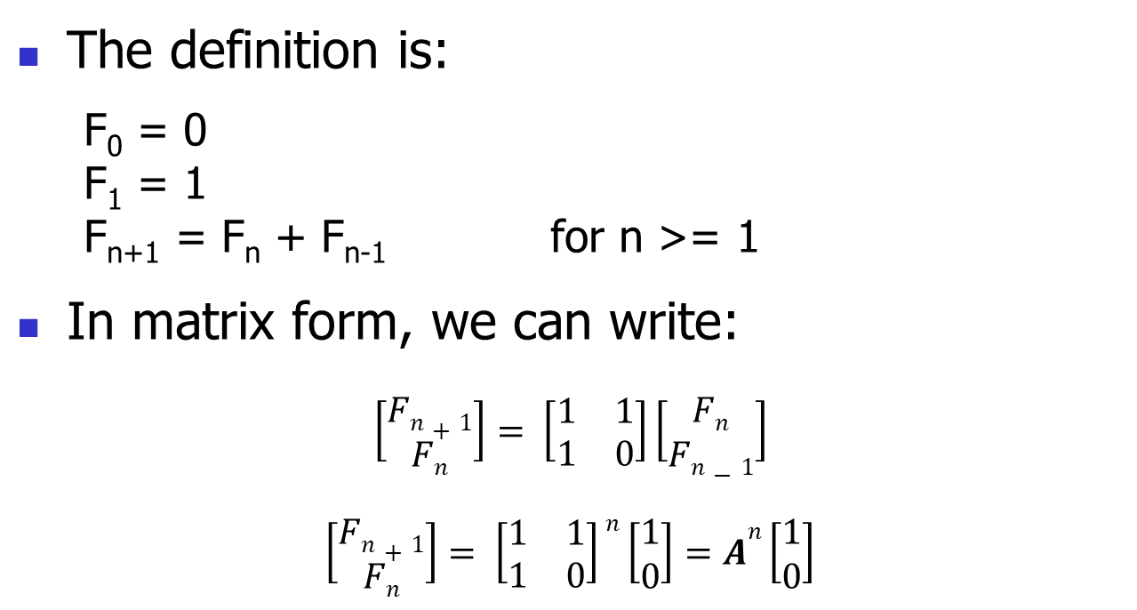
Fibonacci Numbers Again! (cont.)
The definition is:
  F₀ = 0
  F₁ = 1
  F_{n+1} = F_{n} + F_{n-1} for n >= 1
In matrix form, we can write:
$$\left[\begin{matrix}Fn+1 \\ \begin{matrix}Fn\end{matrix}\end{matrix}\right]= \left[\begin{matrix}1 & 1 \\ 1 & 0\end{matrix}\right]\left[\begin{matrix}Fn \\ \begin{matrix}Fn−1\end{matrix}\end{matrix}\right]$$
$$\left[\begin{matrix}Fn+1 \\ \begin{matrix}Fn\end{matrix}\end{matrix}\right]= \left[\begin{matrix}1 & 1 \\ 1 & 0\end{matrix}\right]n\left[\begin{matrix}1 \\ \begin{matrix}0\end{matrix}\end{matrix}\right]=An\left[\begin{matrix}1 \\ \begin{matrix}0\end{matrix}\end{matrix}\right]$$
Notes:
pow() takes two doubles and returns a double:
double sqrt = pow( 4.0, 0.5);
How is this implemented? It’s unnecessarily slow for integer powers, don’t use it for this!

Slide 14
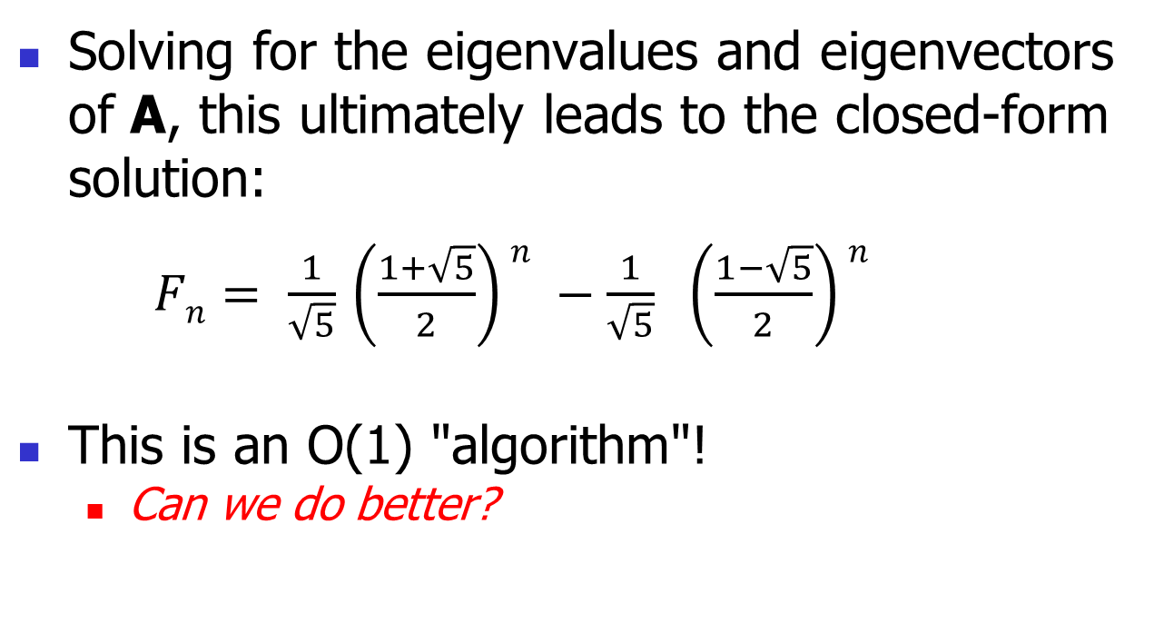
Fibonacci Numbers Again! (cont.)
Solving for the eigenvalues and eigenvectors of A, this ultimately leads to the closed-form solution:
$Fn= \frac{1}{\sqrt{5}}$ $\left(\frac{1+\sqrt{5}}{2}\right)n −\frac{1}{\sqrt{5}} \left(\frac{1−\sqrt{5}}{2}\right)n$
This is an O(1) "algorithm"!
  Can we do better?
Notes:
pow() takes two doubles and returns a double:
double sqrt = pow( 4.0, 0.5);
How is this implemented? It’s unnecessarily slow for integer powers, don’t use it for this!

Slide 15
Fibonacci Numbers Again! (cont.)
Sometimes, even an analytical formula is too slow, or not precise enough
  Our F_{n} formula is computed as a float in Python
    Restricted range of values
In that case, use a lookup table
  Need Fibonacci numbers up to N = 10,000?
    Compute in advance and store in memory!
  An even faster O(1) "algorithm"
Notes:
pow() takes two doubles and returns a double:
double sqrt = pow( 4.0, 0.5);
How is this implemented? It’s unnecessarily slow for integer powers, don’t use it for this!

